Slide 1
Employee Data Analysis using Excel
STUDENT NAME : S.ASHVINI
REGISTER NO : 312208630
DEPARTMENT : B.COM GENERAL
COLLEGE : CHELLAMMAL WOMEN'S COLLEGE

Slide 2
PROJECT TITLE
Employee Performance Analysis Using Excel

Slide 3


AGENDA
Problem Statement
Project Overview
End Users
Our Solution and Proposition
Dataset Description
Modelling Approach
Results and Discussion
Conclusion
3/21/2024 Annual Review

Slide 4

PROBLEM STATEMENT
This presentation aims to analyze existing employee performance data to uncover actionable insights ,develop targeted strategies for performance enhancement and support data driven decision making to foster a more efficient and motivated workforce

Slide 5

PROJECT OVERVIEW
The employee performance data analysis project evaluates metrics like productivity, quality of work, and attendance to identify trends and areas for improvement. By analyzing this data, the project aims to uncover strengths and weaknesses, offering actionable insights and recommendations to enhance overall performance and align with organizational goals

Slide 6

WHO ARE THE END USERS?
HR Managers
Team Leaders
Department Heads
Senior Executives
Performance Analysts
Training and Development Teams
Employee Relations Specialists
Data Analysts etc

Slide 7
OUR SOLUTION AND ITS VALUE PROPOSITION
➢ Filtering: Enhanced data accuracy by isolating relevant subsets, which improved focus on specific performance metrics and streamlined analysis.
➢ Slicer: Enabled interactive data exploration by providing dynamic filtering options, allowing users to easily segment and analyze data across different dimensions.
➢ Pivot Table: Summarized large datasets effectively by aggregating and reorganizing data, facilitating in-depth analysis and insight into key performance indicators.
➢ Graph: Visualized data trends and patterns through charts, making complex information more accessible and actionable for stakeholders.

Slide 8
Dataset Description
Employee dataset - Naan Mudhalvan Dashboard
Total Features - 26
Features Used - 9
Employee ID - Number
Name - Text
Gender - Male and Female
Employee type - Full time, part time, contract
Employee status - Active
Employee Rating - Number
Business Unit - Department

Slide 9

THE "WOW" IN OUR SOLUTION
About more than 100 Female employees in all the departments have fully met the performance expectations and about 15-20 of employees in each department have exceeded the expectation
Male employees have achieved the similar results and have also given exceeding performance in various sectors accordingly
3/21/2024 Annual Review
‹#›

Slide 10
MODELLING
Data Sources and Cleaning
Data was extracted from the NM dashboard for comprehensive analysis.
Cleaned data to remove inconsistencies and duplicates.
Ensured accuracy and completeness for reliable analysis.
Pivot Table Structure
Created pivot tables to summarize and analyze large data sets.
Organized data by dimensions like time periods and employee groups.
Enabled dynamic filtering for in-depth performance insights.
Types of Visualizations
Developed charts and graphs to illustrate performance trends.
Used bar charts for departmental comparisons and line graphs for trends overtime.
Applied heat maps to highlight areas of high and low performance.
‹#›

Slide 11
MODELLING
Key Metrics and Dimensions
Defined dimensions like departments and job roles for detailed analysis.
Ensured metrics align with organizational performance goals.
Insights and Conclusions :
Analyzed visualizations to identify performance patterns and anomalies.
Delved into trends to uncover factors influencing employee performance.
Provided actionable recommendations for improving productivity and engagement.
Data Integration and Transformation :
Applied transformation techniques to standardize and normalize data formats.
Ensured consistency and accuracy across integrated data points.
Reporting and Presentation :
Designed visual aids to effectively communicate insights and recommendations.
Presented key findings and actionable steps for strategy

Slide 12
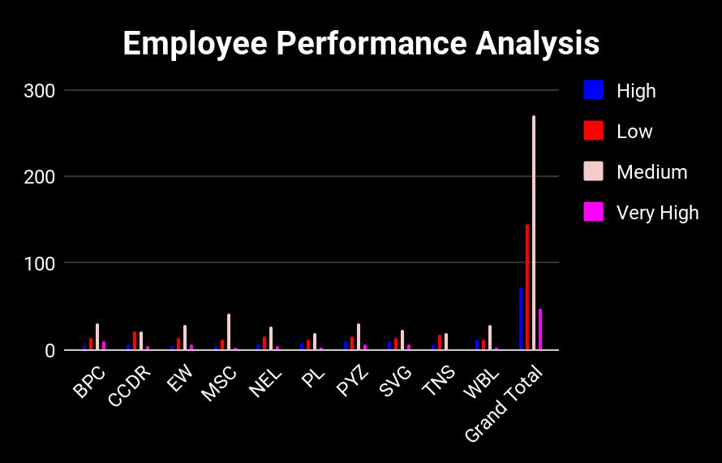
RESULTS
‹#›

Slide 13
conclusion
WITH THE PERFORMANCE BEING SHOWN THAT MORE THAN OR EQUAL TO 100 EMPLOYEES IN BOTH MALE AND FEMALE(EACH DEPARTMENT ) HAVE FULLY MET THE PERFORMANCE EXPECTATION AND LESS THAN OR EQUAL TO 20 EMPLOYEES IN EACH DEPARTMENT BEING EXCEEDING THE EXPECTATION THE REST ARE TAKEN AS ''PIP'' AND ''NEEDS IMPROVEMENT''.
PIP < 15 IN EACH DEPARTMENT
NEEDS IMPROVEMENT < 25 IN EACH DEPARTMENT
THESE NUMBER OF EMPLOYEES MIGHT NEED EXTRA MOTIVATION / TRAINING / PRACTICE ON EFFICIENT PERFORMANCE

